Slide 1
Movie-app
Group 12

Slide 2

Team Members
Miika
Tuukka
Niklas
Ilari
Veeti

Slide 3
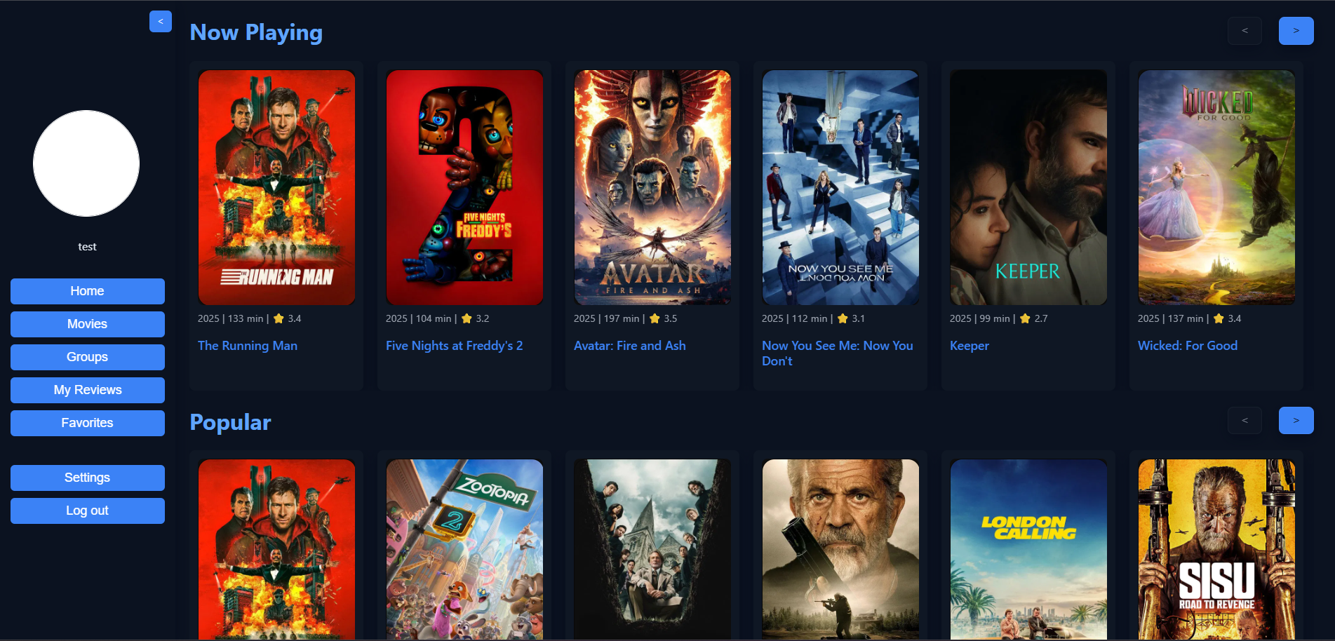
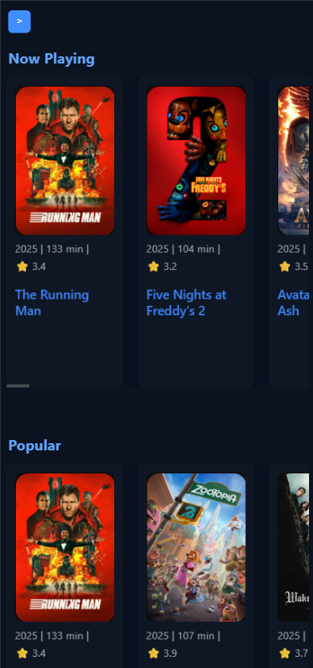
Feature 1/15: Responsivity
Works on desktop and mobile
Layout adapts to different screen sizes
Improved usability on small screens
Implemented with CSS and flexible layouts

Slide 4
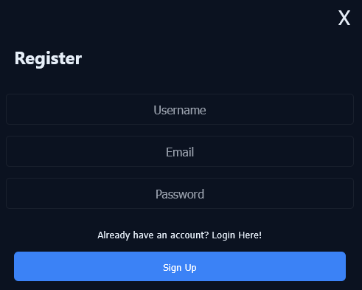
Feature 2/15: Registering
Password requires at least one number and one uppercase letter.
Password validation is performed on the back end.

Slide 5
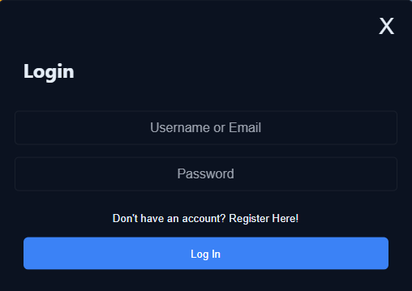
Feature 3/15 : Login
User is able to login to their account, using email or username
Secure authentication using JWT

Slide 6
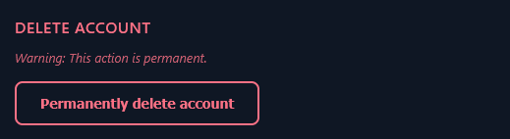
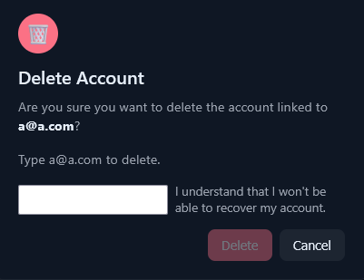
Feature 4/15 : Deleting account
Account deletion permanently erases all related data.
Warnings shown
You must type your email to proceed with deletion.

Slide 7
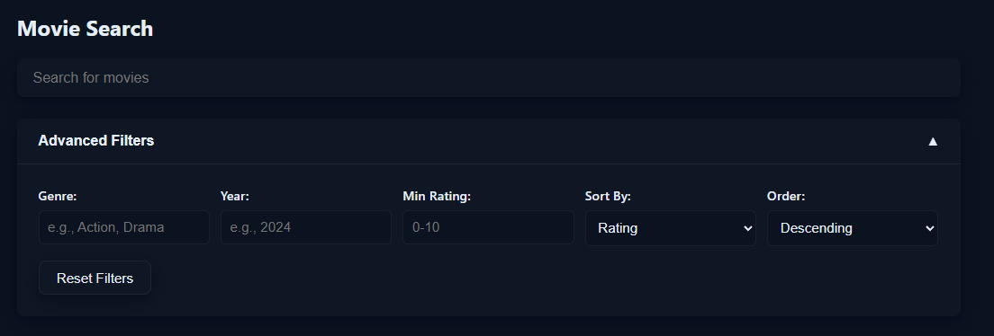
Feature 5/15 : Search bar
Search movies by title
Uses TMDB API
User-friendly
Filtering

Slide 8
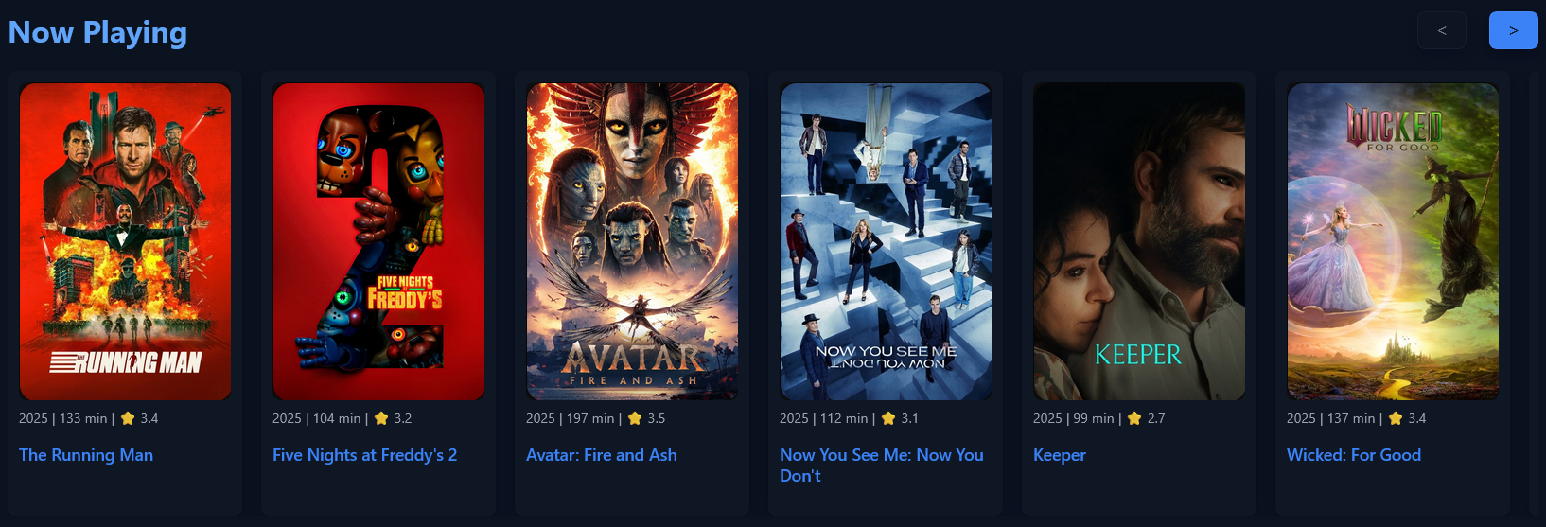
Feature 6/15 : Now in theatres
Displays movie posters, titles, ratings, and release years.
User can slide through and see more information by clicking the title of the movie

Slide 9
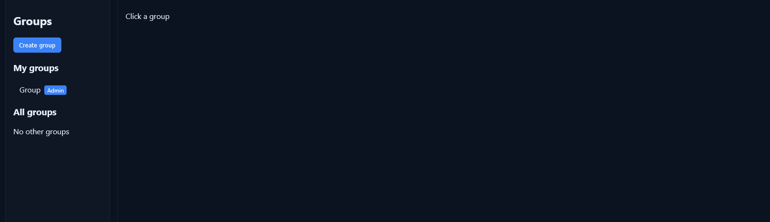
Feature 7/15 : Group page
Show movies that group have added.
All group members see the same content.
Displays movie posters, titles, ratings, and release years.
Allows users to add- and admin to remove movies.
Updates automatically when the group data changes.
Requires user login and group membership.
Admin is able to customize the page.

Slide 10
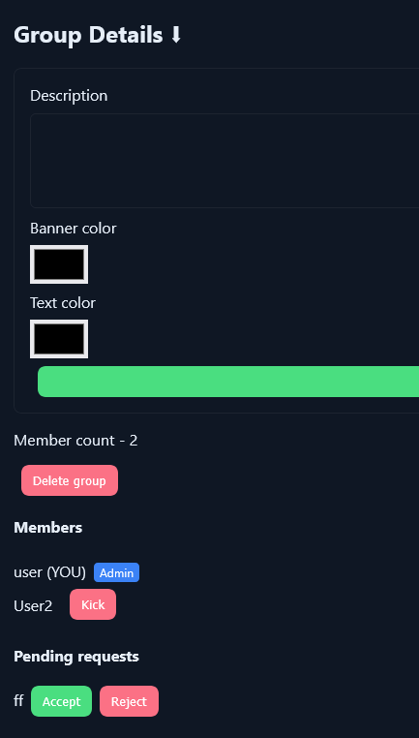
Feature 8/15 : Adding group members
Adding group members work with requests
User finds group from group-page they can then send request to join the group
Then admin of the group can accept the request

Slide 11
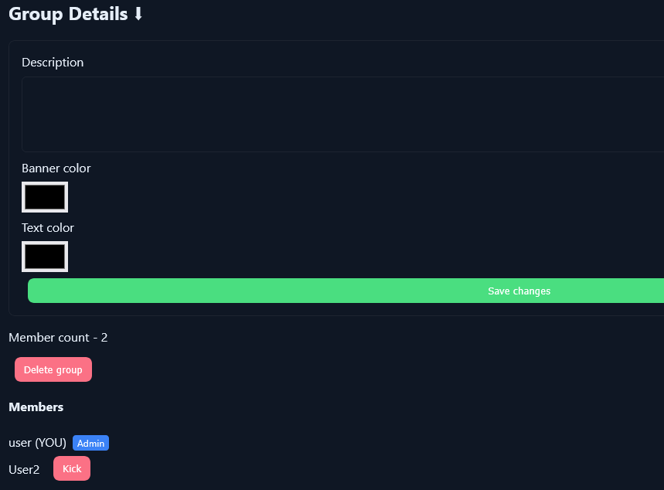
Feature 9/15 : Removing group members
Admin can remove group members.
User can leave group if they wish

Slide 12
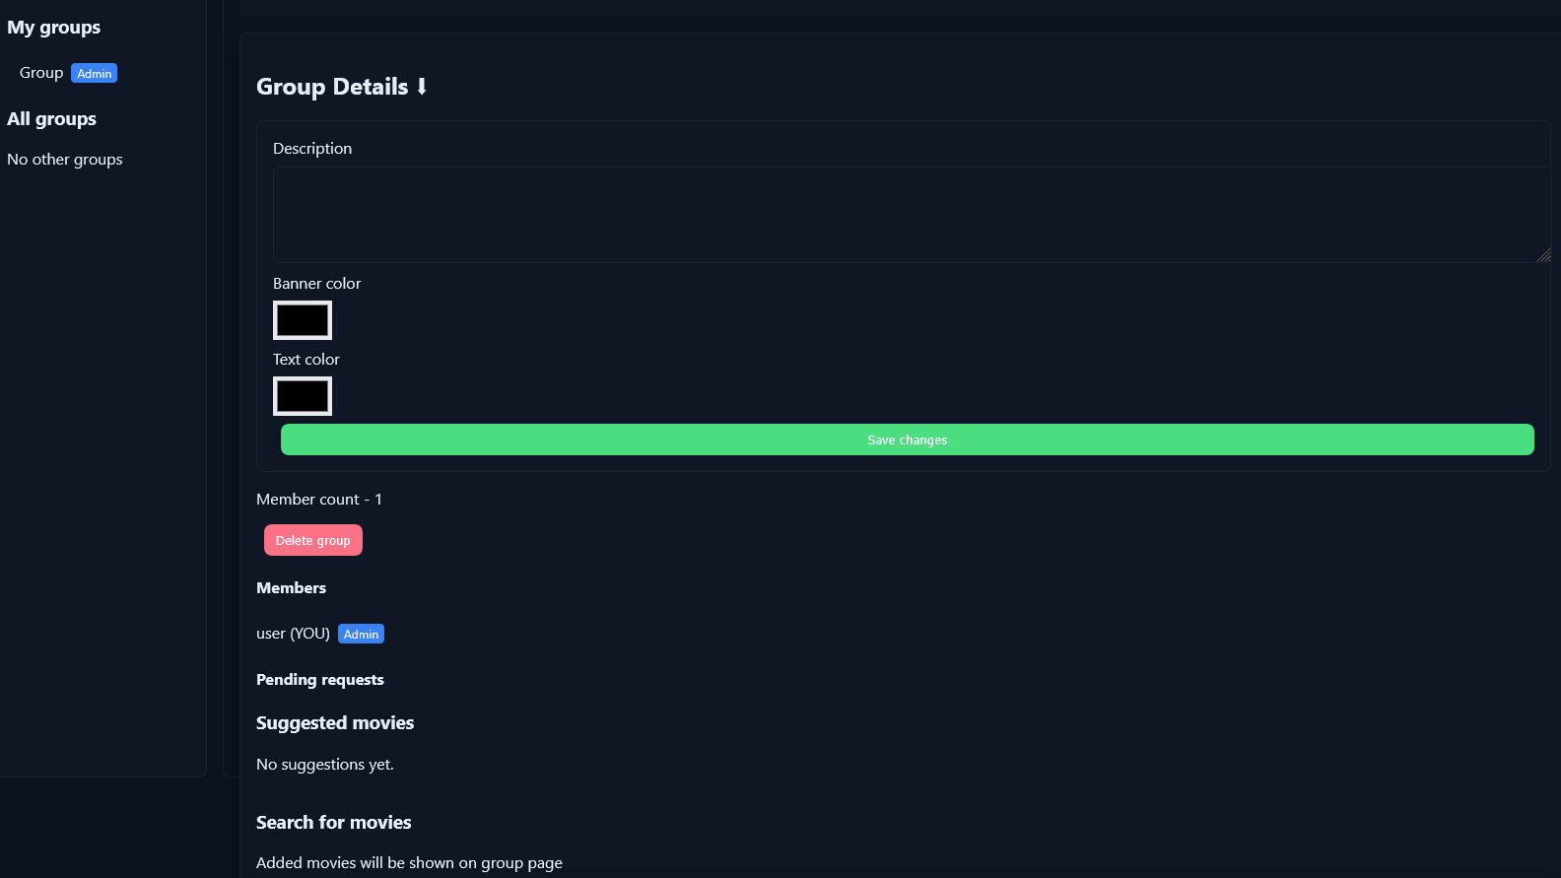
Feature 10/15 : Customization group page
Admins can customize the group page coloring and description inside the group-pages group view

Slide 13
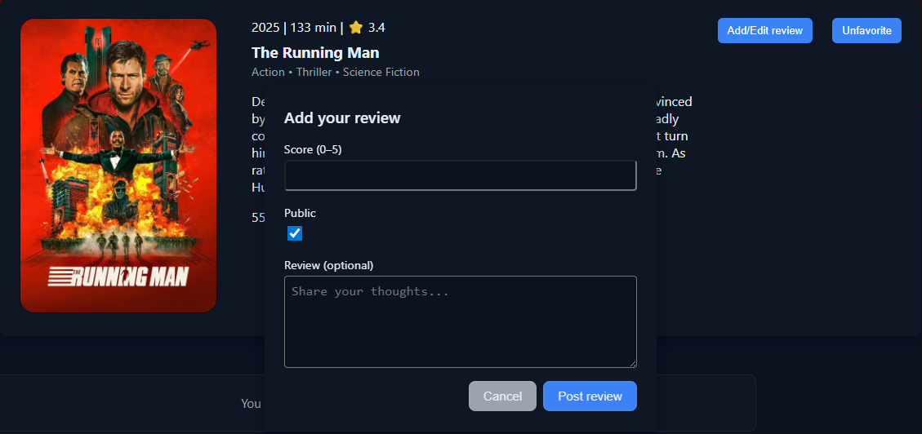
Feature 11/15 : Movie rating
Score movies on a 0-5 star scale
Can share thoughts
One rating per user per movie

Slide 14
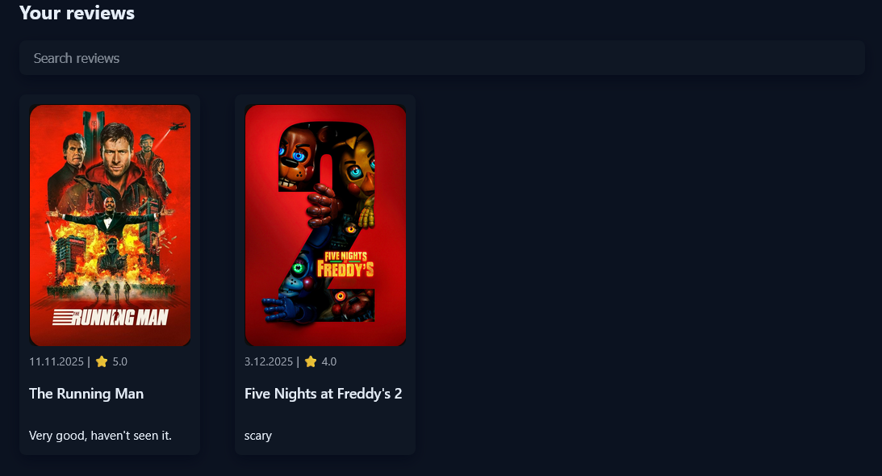
Feature 12/15 : Searching ratings
User can search through their reviews.
User can search specific reviews by typing the movies name to the search bar.

Slide 15
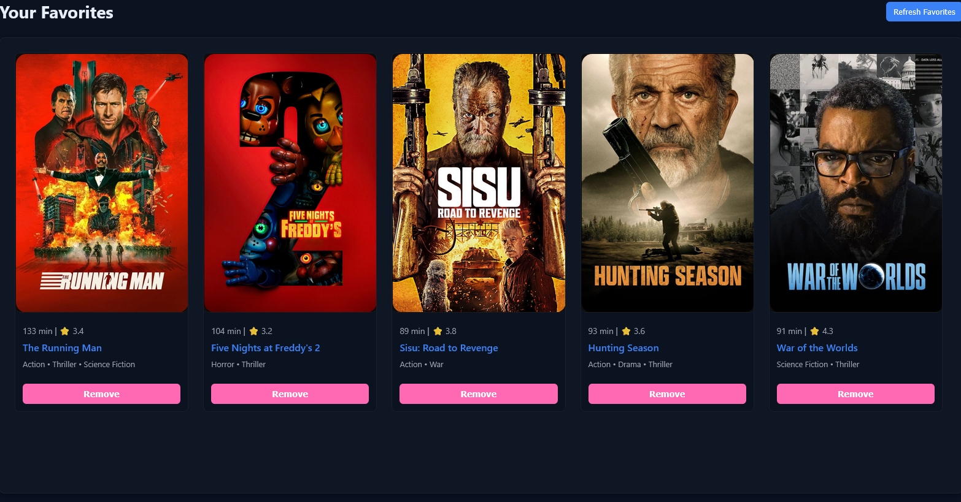
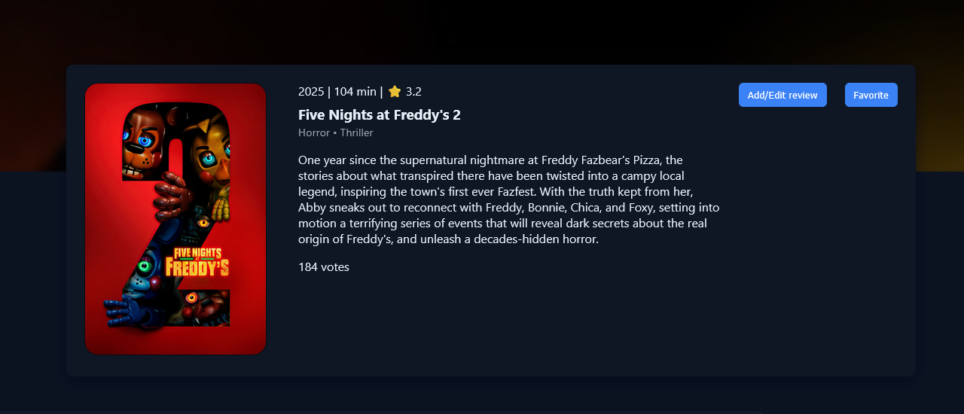
Feature 13/15 : Favorite movies
Users can add and remove movies to their favorite movie list.
The client retrieves all movie information (reviews, poster, title etc...) from The Movie Database.
The received information is then saved in the database.

Slide 16
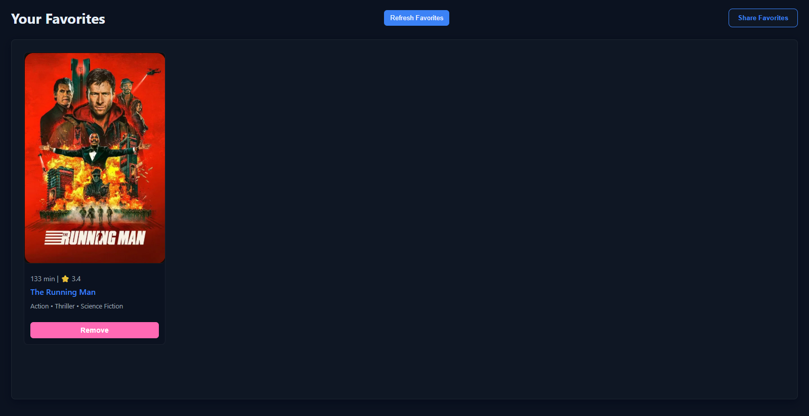
Feature 14/15 : Sharing favorite movies
Users can share their favorite movie list
Favorites can be accessed via a public link
No login required to view shared list
Easy way to recommend movies to others

Slide 17
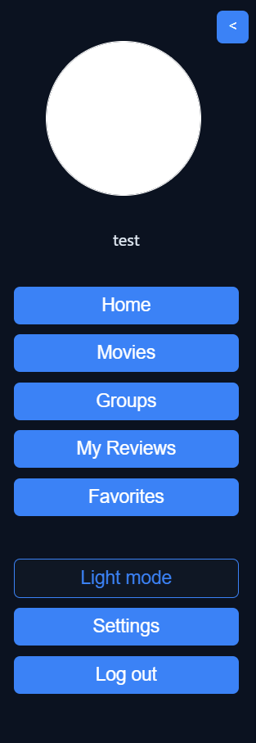
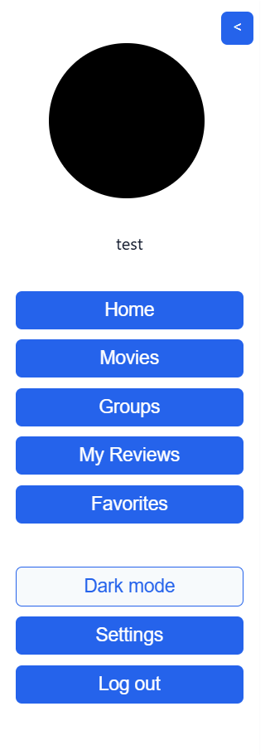
Feature 15/15 : Profile picture and dark mode switch
We made profile picture as our optional feature.
User can upload profile pictures
Profile picture gets stored in the backend and the URL gets stored inside the database.
On log in, the client fetches the URL and loads the profile picture
Dark mode switch switches between dark and light style

Slide 18
Conclusion
15/15 features successfully implemented
Full-stack web application
Learning experience
Thank you for listening!

